Slide 1
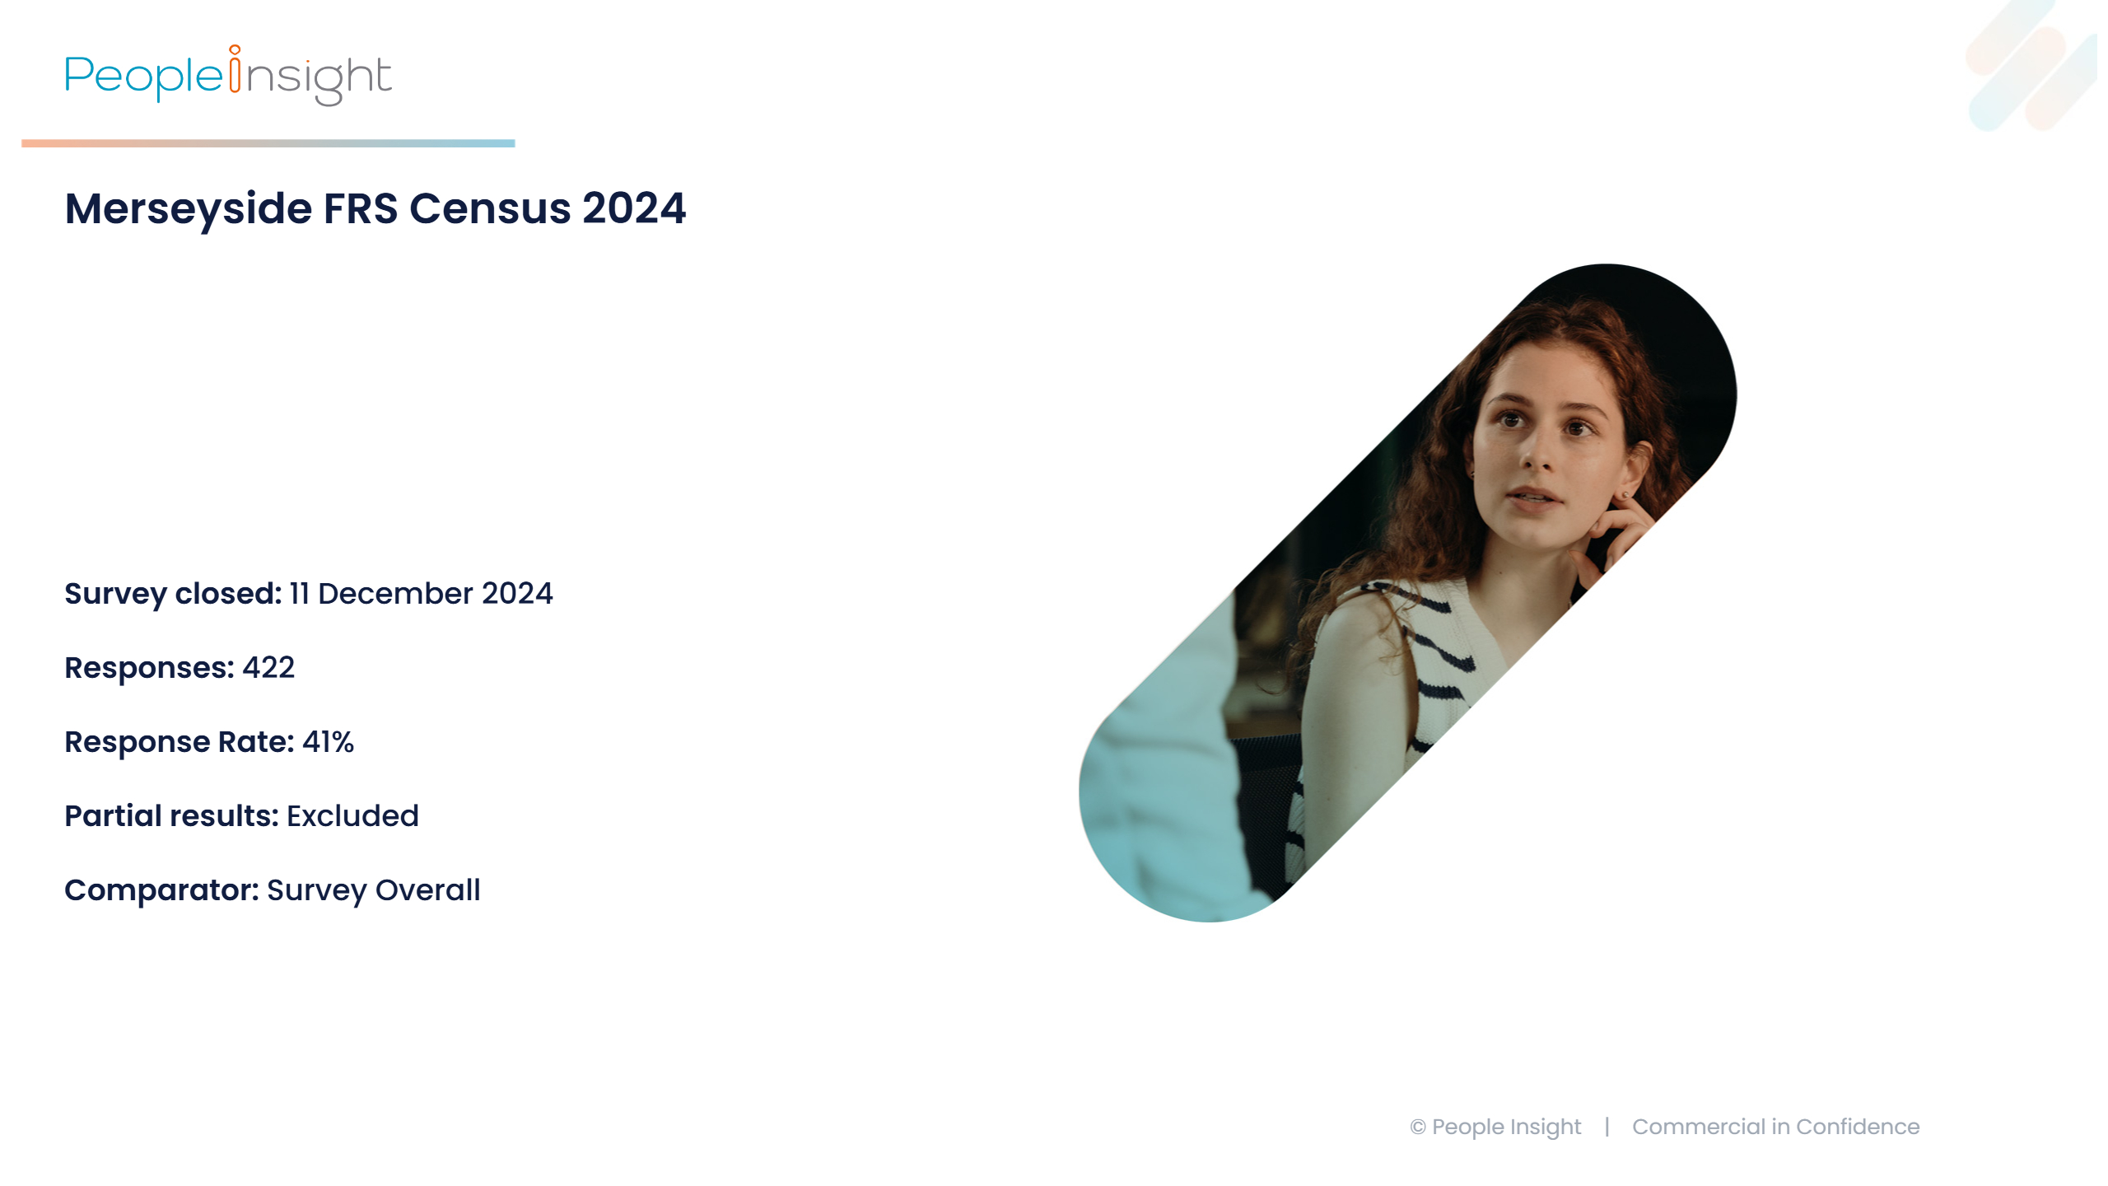
Notes:
Merseyside FRS Census 2024 by People Insight. The slide includes the People Insight logo at the top left and a right-side image of a thoughtful woman with curly hair. Key survey details are listed:
• Survey closed: <span>11 December 2024</span>
• Filters: n/a
• Responses: 422
• Response Rate: 41%
• Partial results: Excluded
• Comparator: Survey Overall
Footer reads © People Insight | Commercial in Confidence.

Slide 2
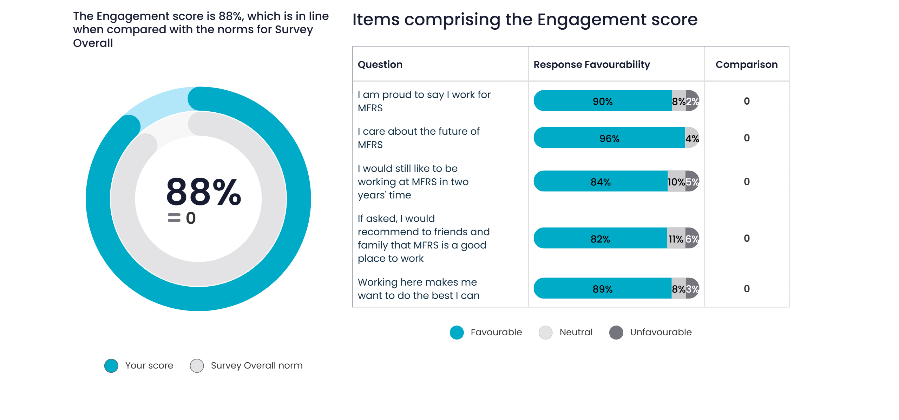
What is our Engagement score?
Notes:
The slide displays an overall Engagement score of 88%, visually represented by a circular graphic comparing "Your score" and "Survey Overall." On the right, a table lists questions related to Engagement with response favourability percentages for each question. The comparator score is not listed, just the difference. This is the data in the table:
I am proud to say I work for MFRS response favourable score (90% positive; 8% neutral and 2% negative), comparator difference (0)
I care about the future of MFRS response favourable score (96% positive; 4% neutral and 0% negative), comparator difference (0)
I would still like to be working at MFRS in two years' time response favourable score (84% positive; 10% neutral and 5% negative), comparator difference (0)
If asked, I would recommend to friends and family that MFRS is a good place to work response favourable score (82% positive; 11% neutral and 6% negative), comparator difference (0)
Working here makes me want to do the best I can response favourable score (89% positive; 8% neutral and 3% negative), comparator difference (0)
Response categories include "Favourable, Neutral, Unfavourable."
Footer reads © People Insight | Commercial in Confidence.

Slide 3
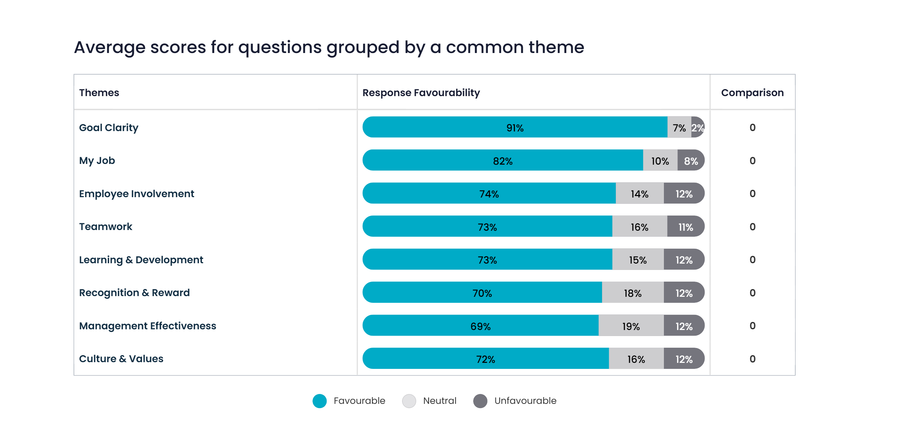
What are our Theme scores? (1 to 8)
Notes:
The slide displays a table of average scores for questions grouped by common themes with response favourability percentages. There is a column next to the score for each theme which indicates the difference compared to the comparator. The comparator score is not listed, just the difference.
This is the data listed in the table:
Goal Clarity response favourable score (91% positive; 7% neutral and 2% negative), comparator difference (0)
My Job response favourable score (82% positive; 10% neutral and 8% negative), comparator difference (0)
Employee Involvement response favourable score (74% positive; 14% neutral and 12% negative), comparator difference (0)
Teamwork response favourable score (73% positive; 16% neutral and 11% negative), comparator difference (0)
Learning & Development response favourable score (73% positive; 15% neutral and 12% negative), comparator difference (0)
Recognition & Reward response favourable score (70% positive; 18% neutral and 12% negative), comparator difference (0)
Management Effectiveness response favourable score (69% positive; 19% neutral and 12% negative), comparator difference (0)
Culture & Values response favourable score (72% positive; 16% neutral and 12% negative), comparator difference (0)
Each theme shows the proportion of responses as "Favourable, Neutral, Unfavourable." A legend below the table indicates colours representing each response type.
Footer reads © People Insight | Commercial in Confidence.

Slide 4
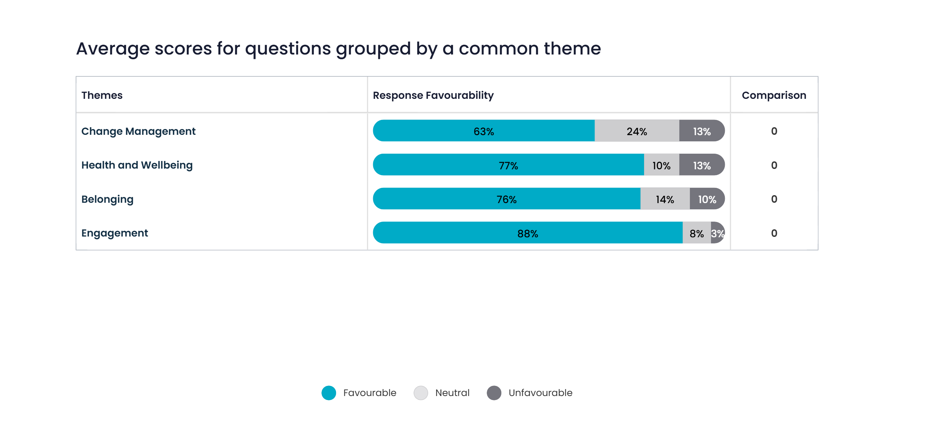
What are our Theme scores? (9 to 12)
Notes:
The slide displays a table of average scores for questions grouped by common themes with response favourability percentages. There is a column next to the score for each theme which indicates the difference compared to the comparator. The comparator score is not listed, just the difference.
This is the data listed in the table:
Change Management response favourable score (63% positive; 24% neutral and 13% negative), comparator difference (0)
Health and Wellbeing response favourable score (77% positive; 10% neutral and 13% negative), comparator difference (0)
Belonging response favourable score (76% positive; 14% neutral and 10% negative), comparator difference (0)
Engagement response favourable score (88% positive; 8% neutral and 3% negative), comparator difference (0)
Each theme shows the proportion of responses as "Favourable, Neutral, Unfavourable." A legend below the table indicates colours representing each response type.
Footer reads © People Insight | Commercial in Confidence.

Slide 5
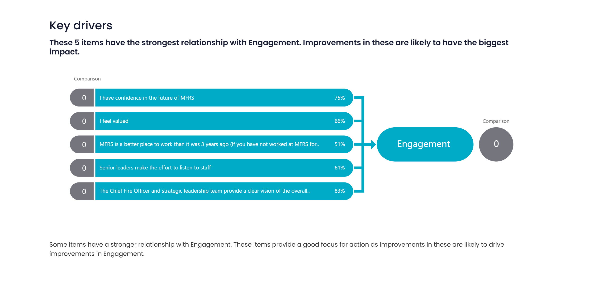
What is driving our Engagement score?
Notes:
The slide displays in a table the key drivers impacting Engagement, with an image featuring a central section listing five questions that have the strongest correlation to Engagement. Next to each question the responsive favourable percentage is included and the difference to the comparator.
This is the data listed in the table:
I have confidence in the future of MFRS response favourable score (75% positive; 16% neutral and 9% negative), comparator difference (0)
I feel valued response favourable score (66% positive; 19% neutral and 15% negative), comparator difference (0)
MFRS is a better place to work than it was 3 years ago (If you have not worked at MFRS for 3 years, please skip this question) response favourable score (51% positive; 37% neutral and 12% negative), comparator difference (0)
Senior leaders make the effort to listen to staff response favourable score (61% positive; 24% neutral and 15% negative), comparator difference (0)
The Chief Fire Officer and strategic leadership team provide a clear vision of the overall direction of MFRS response favourable score (83% positive; 14% neutral and 4% negative), comparator difference (0)
There is text which notes the importance of focusing on these items for improving Engagement.
Footer reads © People Insight | Commercial in Confidence.

Slide 6
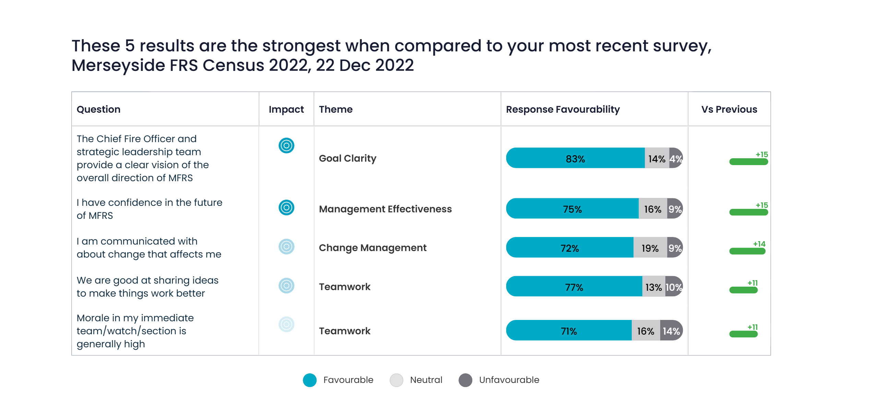
Best compared to history
Notes:
The slide displays the five strongest results when compared to your most recent survey Merseyside FRS Census 2022, 22 Dec 2022.
The table includes the questions, their impact, associated themes, response favourability percentages, and the comparison score against the selected comparator.
The table lists questions, their impact, associated themes, response favourability percentages categorised into "Favourable, Neutral, Unfavourable”, and comparison to previous results.
This the data in the table:
The Chief Fire Officer and strategic leadership team provide a clear vision of the overall direction of MFRS (Goal Clarity) response favourable score (83% positive; 14% neutral and 4% negative), comparator difference (15)
I have confidence in the future of MFRS (Management Effectiveness) response favourable score (75% positive; 16% neutral and 9% negative), comparator difference (15)
I am communicated with about change that affects me (Change Management) response favourable score (72% positive; 19% neutral and 9% negative), comparator difference (14)
We are good at sharing ideas to make things work better (Teamwork) response favourable score (77% positive; 13% neutral and 10% negative), comparator difference (11)
Morale in my immediate team/watch/section is generally high (Teamwork) response favourable score (71% positive; 16% neutral and 14% negative), comparator difference (11)
Footer reads © People Insight | Commercial in Confidence.

Slide 7
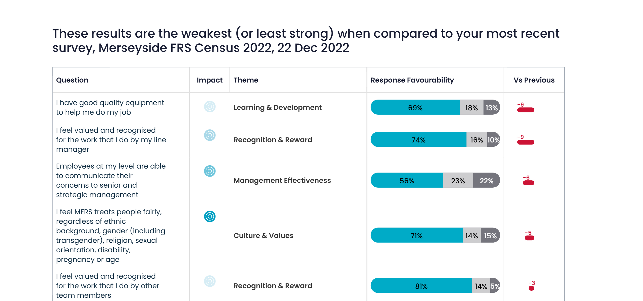
Weakest compared to history
Notes:
The slide displays the five weakest (or least strong) results when compared to your most recent survey Merseyside FRS Census 2022, 22 Dec 2022
The table includes the questions, their impact, associated themes, response favourability percentages, and the comparison score against the selected comparator.
The table lists questions, their impact, associated themes, response favourability percentages categorised into "Favourable, Neutral, Unfavourable”, and comparison to previous results.
This the data in the table:
I have good quality equipment to help me do my job (Learning & Development) response favourable score (69% positive; 18% neutral and 13% negative), comparator difference (-9)
I feel valued and recognised for the work that I do by my line manager (Recognition & Reward) response favourable score (74% positive; 16% neutral and 10% negative), comparator difference (-9)
Employees at my level are able to communicate their concerns to senior and strategic management (Management Effectiveness) response favourable score (56% positive; 23% neutral and 22% negative), comparator difference (-6)
I feel MFRS treats people fairly, regardless of ethnic background, gender (including transgender), religion, sexual orientation, disability, pregnancy or age (Culture & Values) response favourable score (71% positive; 14% neutral and 15% negative), comparator difference (-5)
I feel valued and recognised for the work that I do by other team members (Recognition & Reward) response favourable score (81% positive; 14% neutral and 5% negative), comparator difference (-3)
Footer reads © People Insight | Commercial in Confidence.

Slide 8
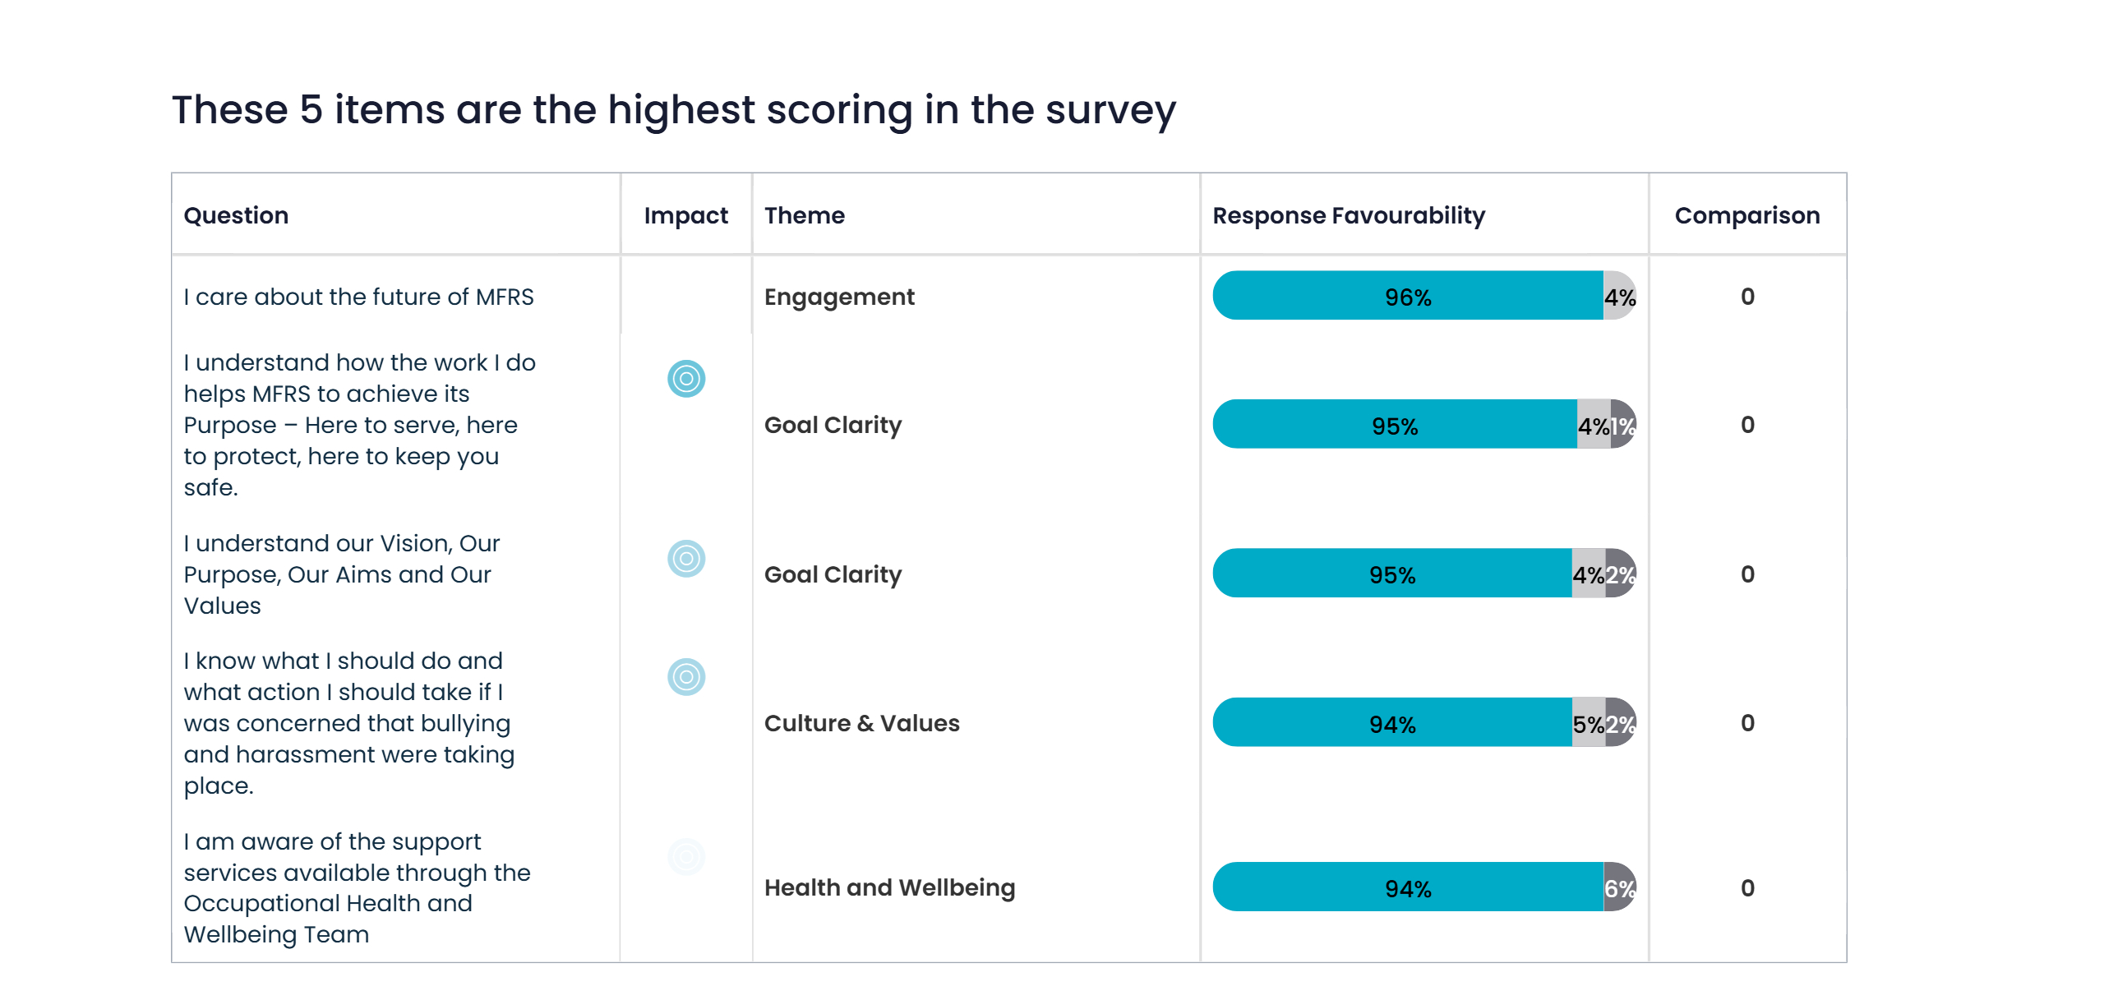
What are our highest scoring questions?
Notes:
The slide displays in a table the five highest-scoring items in the survey. The table includes the questions, their impact, associated themes, response favourability percentages, and the comparison score against the selected comparator.
The table lists questions, their impact, associated themes, response favourability percentages categorised into "Favourable, Neutral, Unfavourable”, and comparison to previous results.
This the data in the table:
I care about the future of MFRS (Engagement) response favourable score (96% positive; 4% neutral and 0% negative), comparator difference (0)
I understand how the work I do helps MFRS to achieve its Purpose – Here to serve, here to protect, here to keep you safe. (Goal Clarity) response favourable score (95% positive; 4% neutral and 1% negative), comparator difference (0)
I understand our Vision, Our Purpose, Our Aims and Our Values (Goal Clarity) response favourable score (95% positive; 4% neutral and 2% negative), comparator difference (0)
I am aware of the support services available through the Occupational Health and Wellbeing Team (Health and Wellbeing) response favourable score (94% positive; 0% neutral and 6% negative), comparator difference (0)
I know what I should do and what action I should take if I was concerned that bullying and harassment were taking place. (Culture & Values) response favourable score (94% positive; 5% neutral and 2% negative), comparator difference (0)
Footer reads © People Insight | Commercial in Confidence.

Slide 9
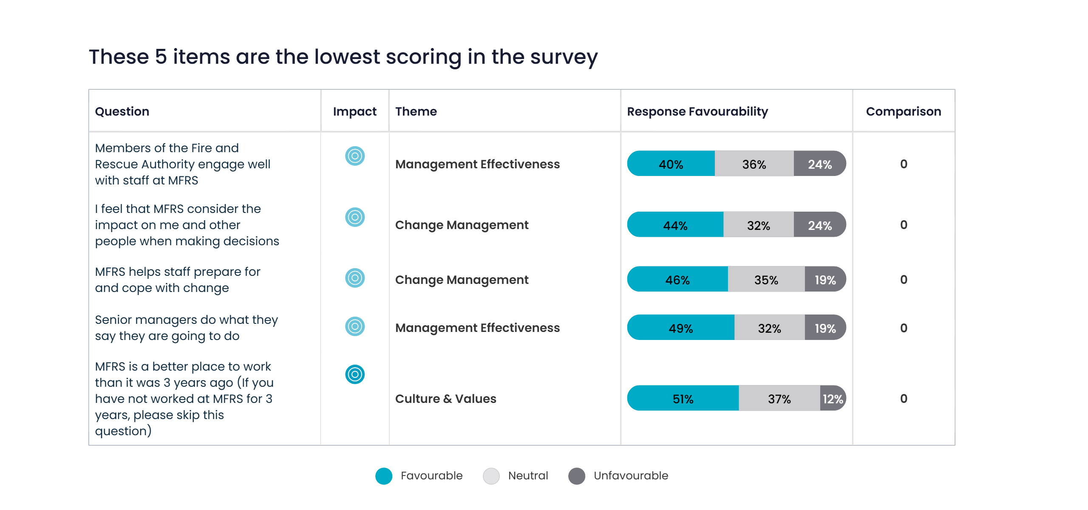
What are our lowest scoring questions?
Notes:
The slide displays in a table the five lowest-scoring items in the survey. The table includes the questions, their impact, associated themes, response favourability percentages, and the comparison score against the selected comparator.
The table lists questions, their impact, associated themes, response favourability percentages categorised into "Favourable, Neutral, Unfavourable”, and comparison to previous results.
This the data in the table:
Members of the Fire and Rescue Authority engage well with staff at MFRS (Management Effectiveness) response favourable score (40% positive; 36% neutral and 24% negative), comparator difference (0)
I feel that MFRS consider the impact on me and other people when making decisions (Change Management) response favourable score (44% positive; 32% neutral and 24% negative), comparator difference (0)
MFRS helps staff prepare for and cope with change (Change Management) response favourable score (46% positive; 35% neutral and 19% negative), comparator difference (0)
Senior managers do what they say they are going to do (Management Effectiveness) response favourable score (49% positive; 32% neutral and 19% negative), comparator difference (0)
MFRS is a better place to work than it was 3 years ago (If you have not worked at MFRS for 3 years, please skip this question) (Culture & Values) response favourable score (51% positive; 37% neutral and 12% negative), comparator difference (0)
Footer reads© People Insight | Commercial in Confidence.

Slide 10
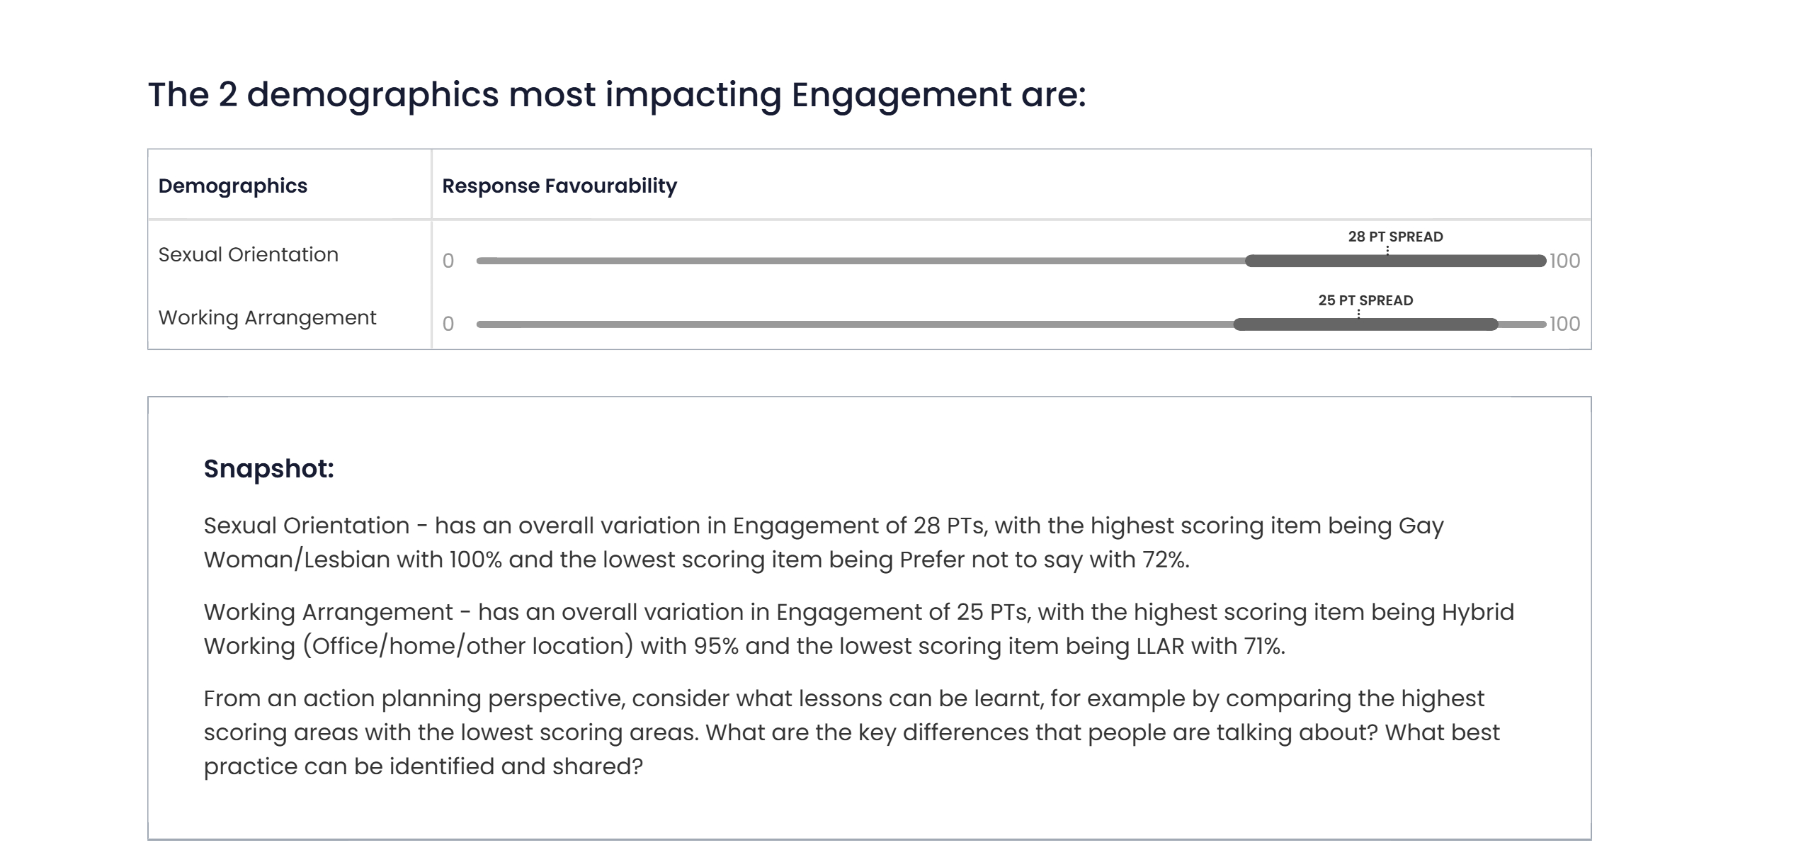
Which demographics affect our Engagement score?
Notes:
The slide displays in a chart the two demographics which most impact Engagement score which are
Sexual Orientation with percentage point spread of 28 PTs
Working Arrangement with percentage point spread of 25 PTs
The supporting snapshot text is included and says:
“Sexual Orientation - has an overall variation in Engagement of 28 PTs, with the highest scoring item being Gay Woman/Lesbian with 100% and the lowest scoring item being Prefer not to say with 72%.
Working Arrangement - has an overall variation in Engagement of 25 PTs, with the highest scoring item being Hybrid Working (Office/home/other location) with 95% and the lowest scoring item being LLAR with 71%.
From an action planning perspective, consider what lessons can be learnt, for example by comparing the highest scoring areas with the lowest scoring areas. What are the key differences that people are talking about? What best practice can be identified and shared?”
Footer reads © People Insight | Commercial in Confidence.

